Slide 1
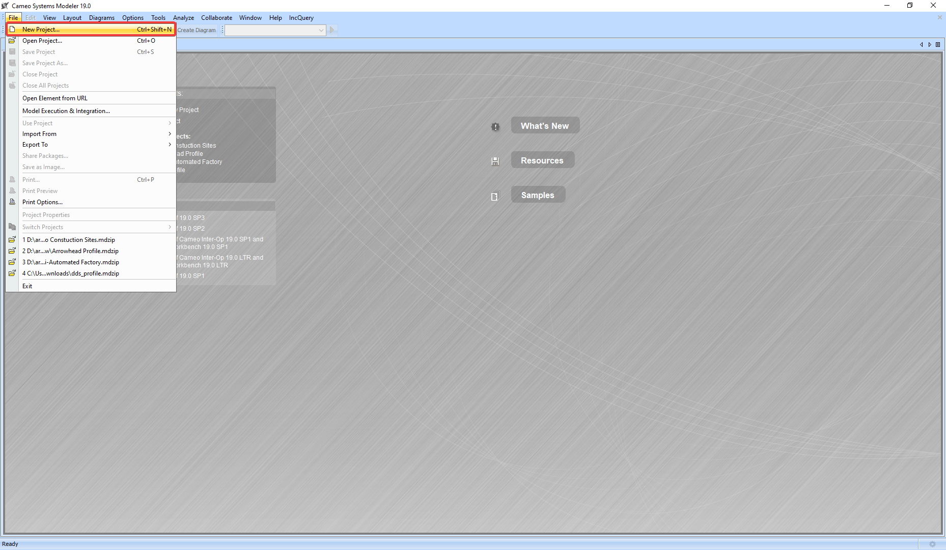
1: Create a new project

Slide 2
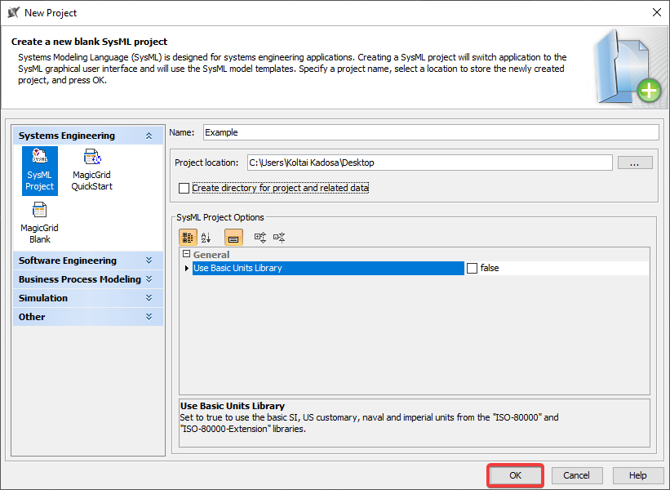
1: Create a new project

Slide 3
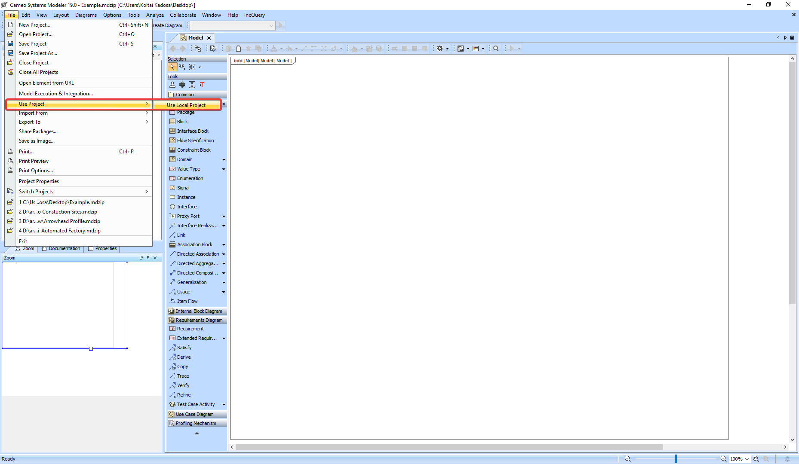
2: Import the Arrowhead Profile

Slide 4
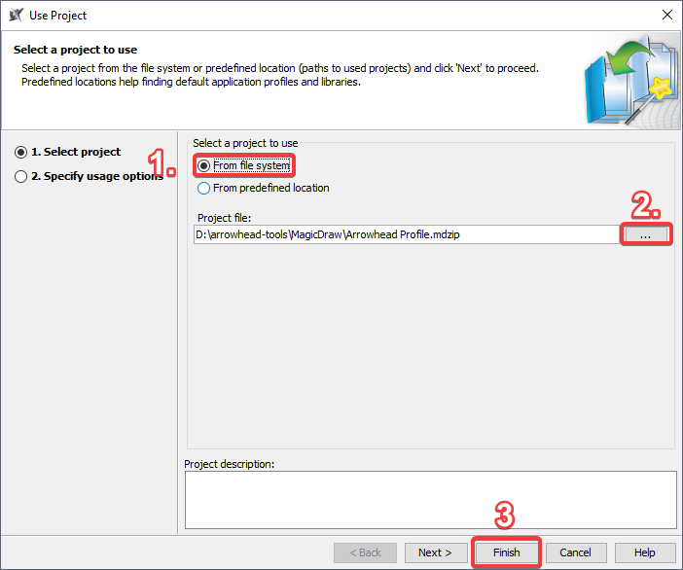
2: Import the Arrowhead Profile

Slide 5
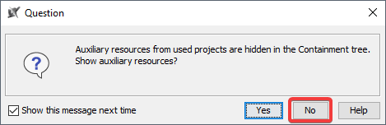
3: Don’t worry about auxiliary resources

Slide 6
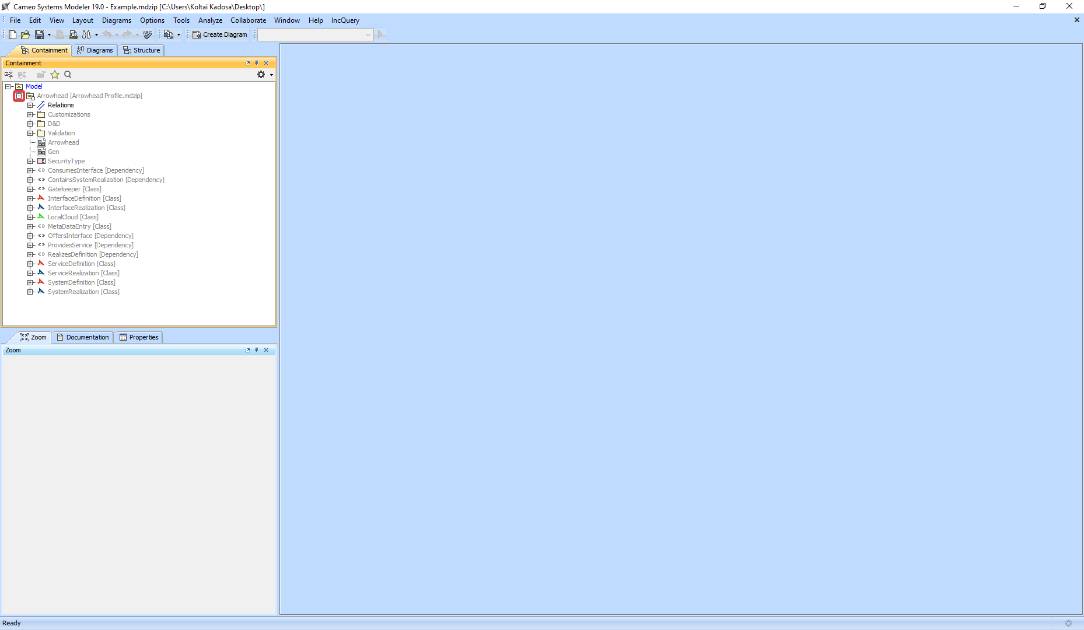
4: Open the package containing the stereotypes

Slide 7
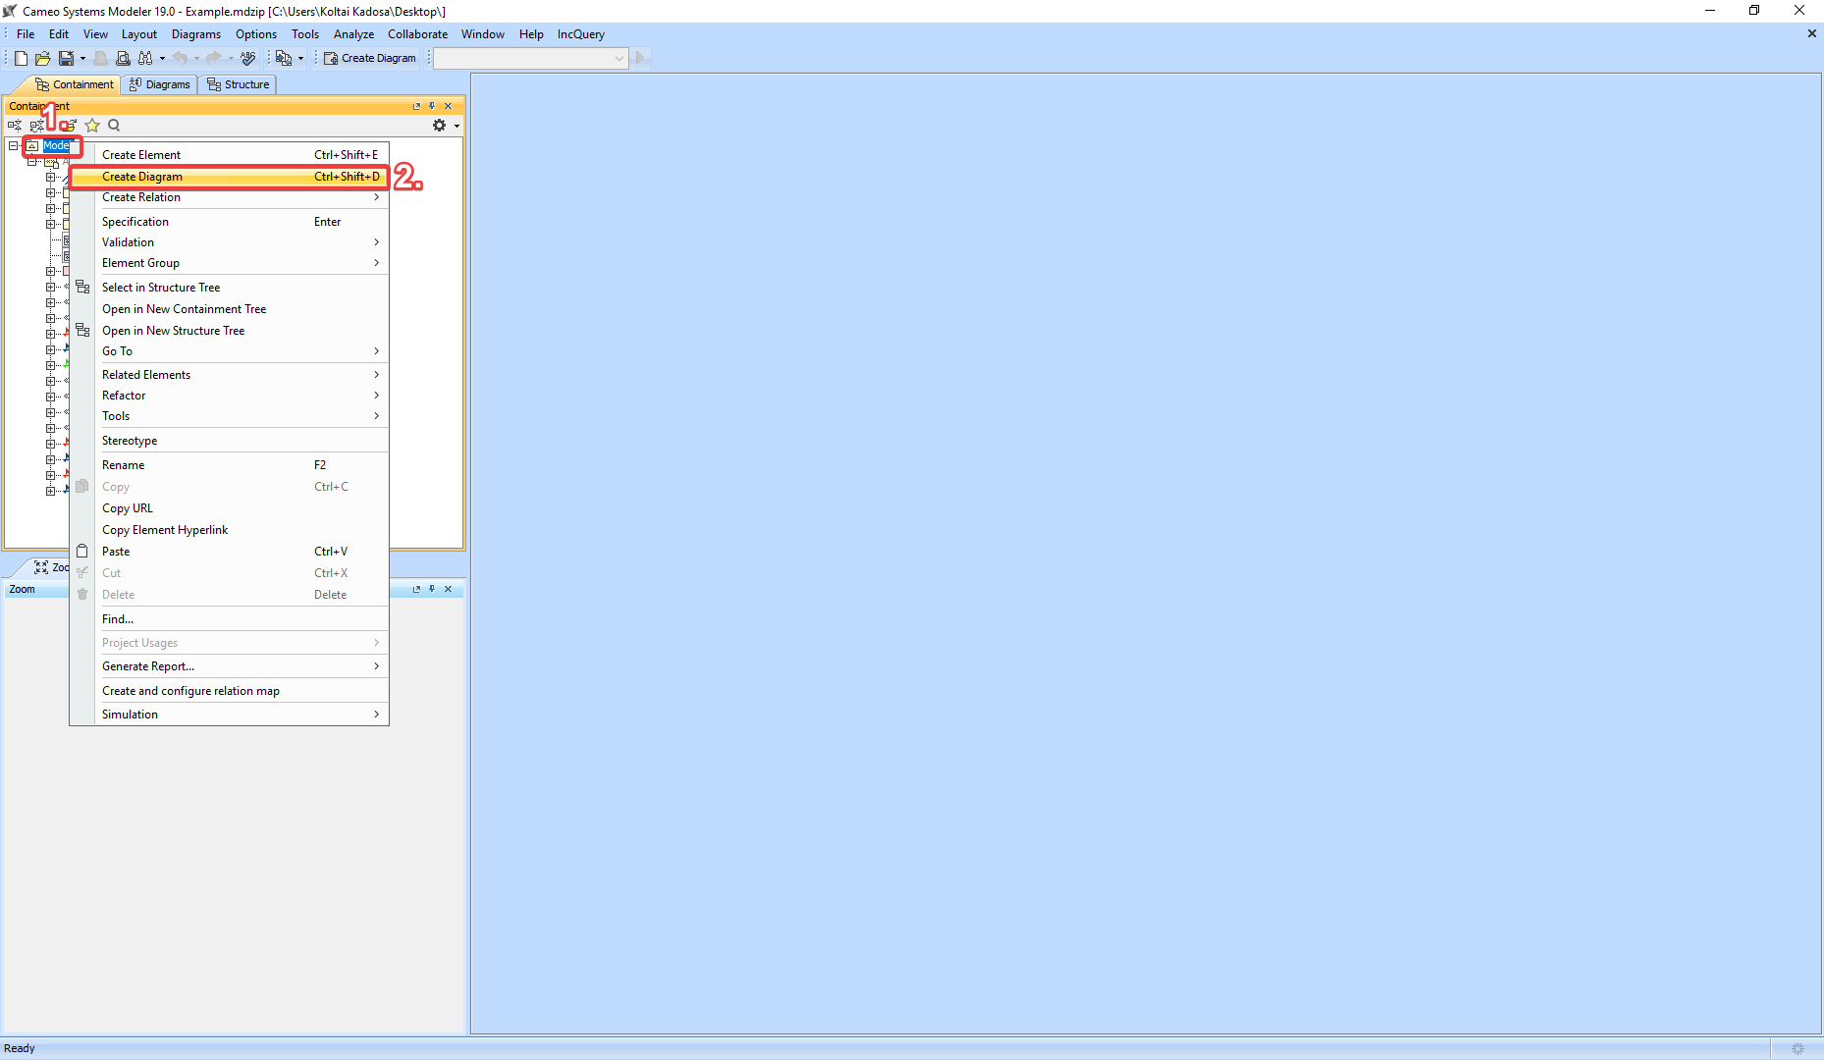
5: Create the BDD

Slide 8
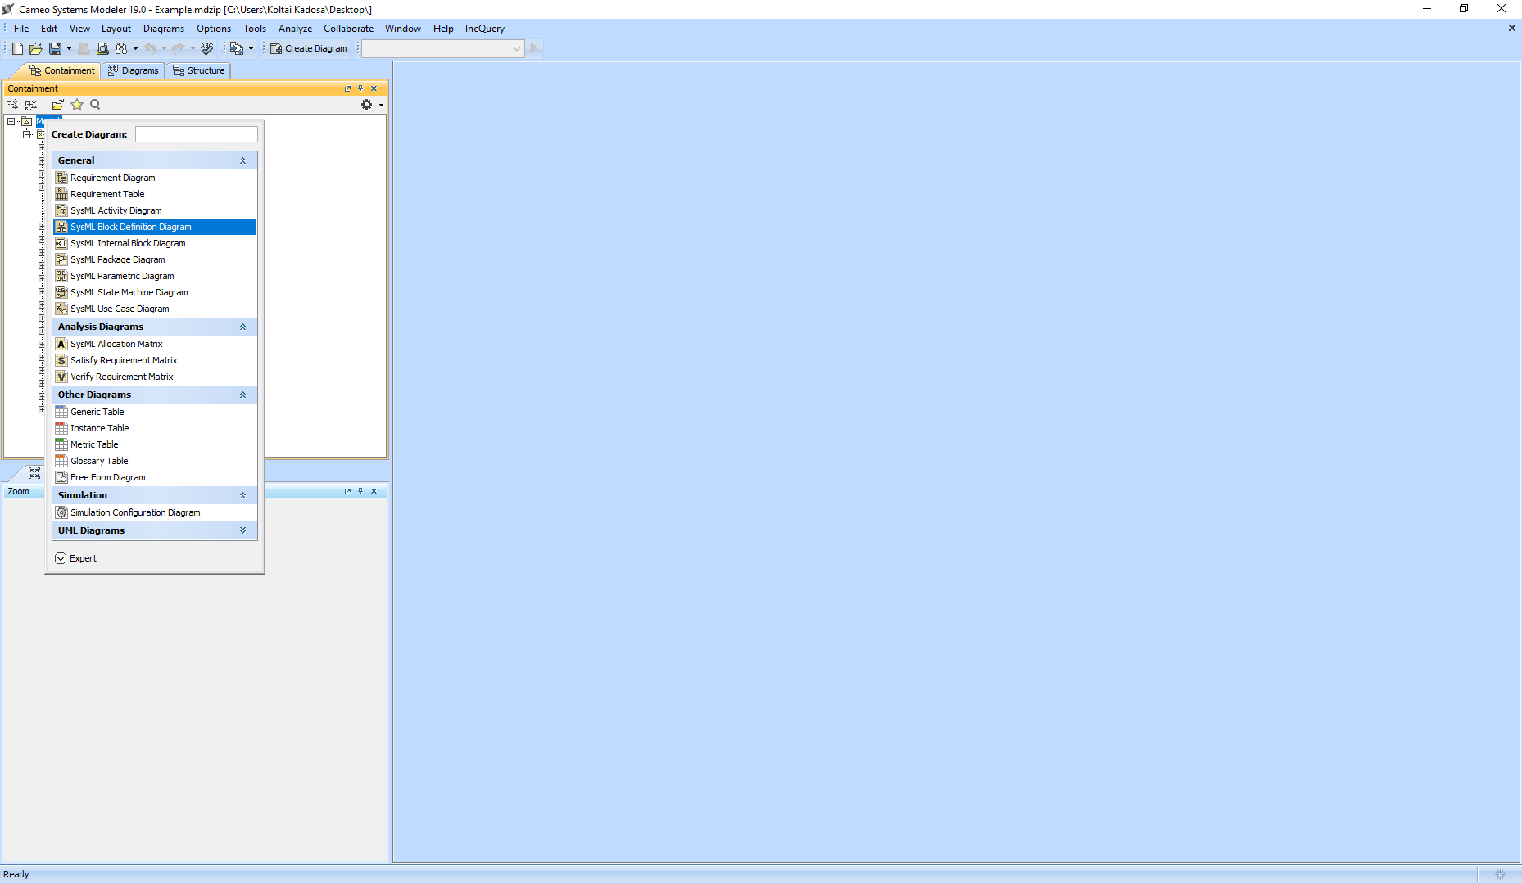
5: Create the BDD

Slide 9
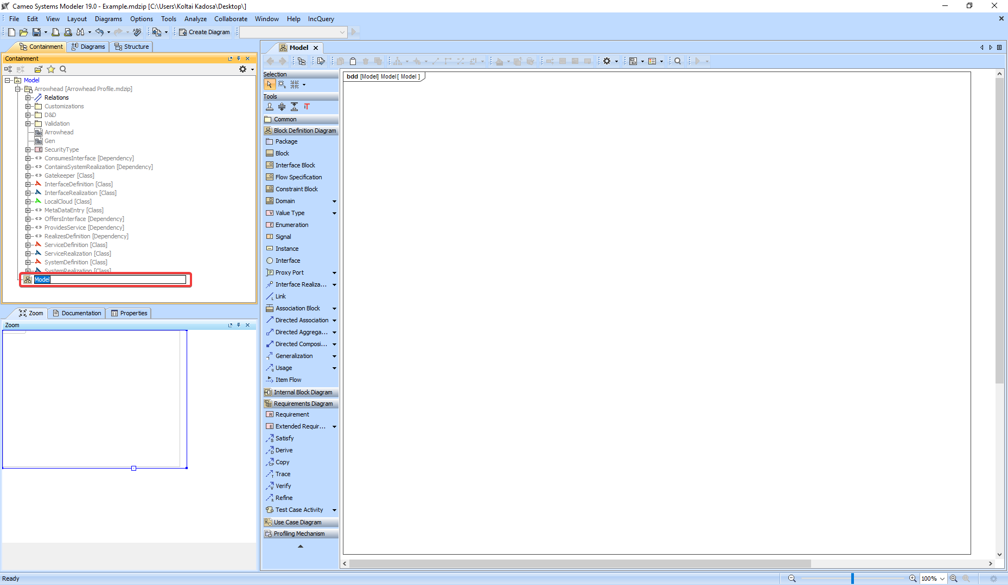
Name it whatever

Slide 10
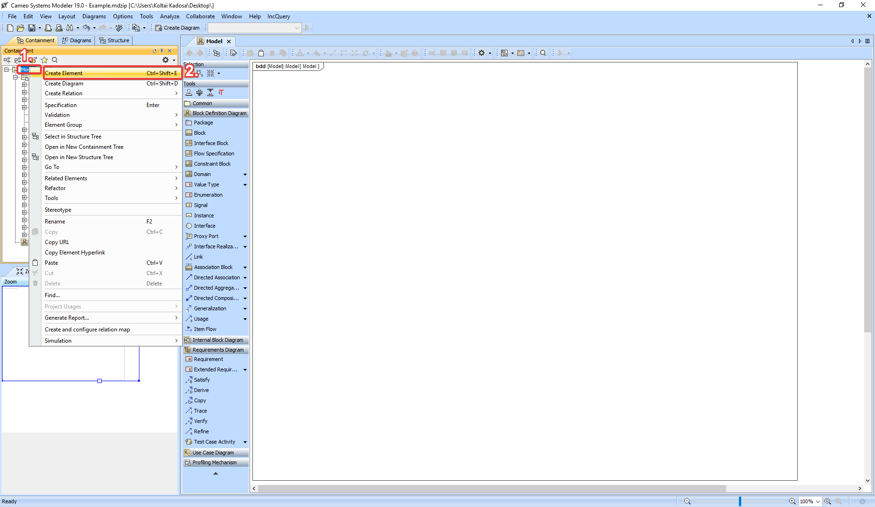
6: Create the System Definition

Slide 11
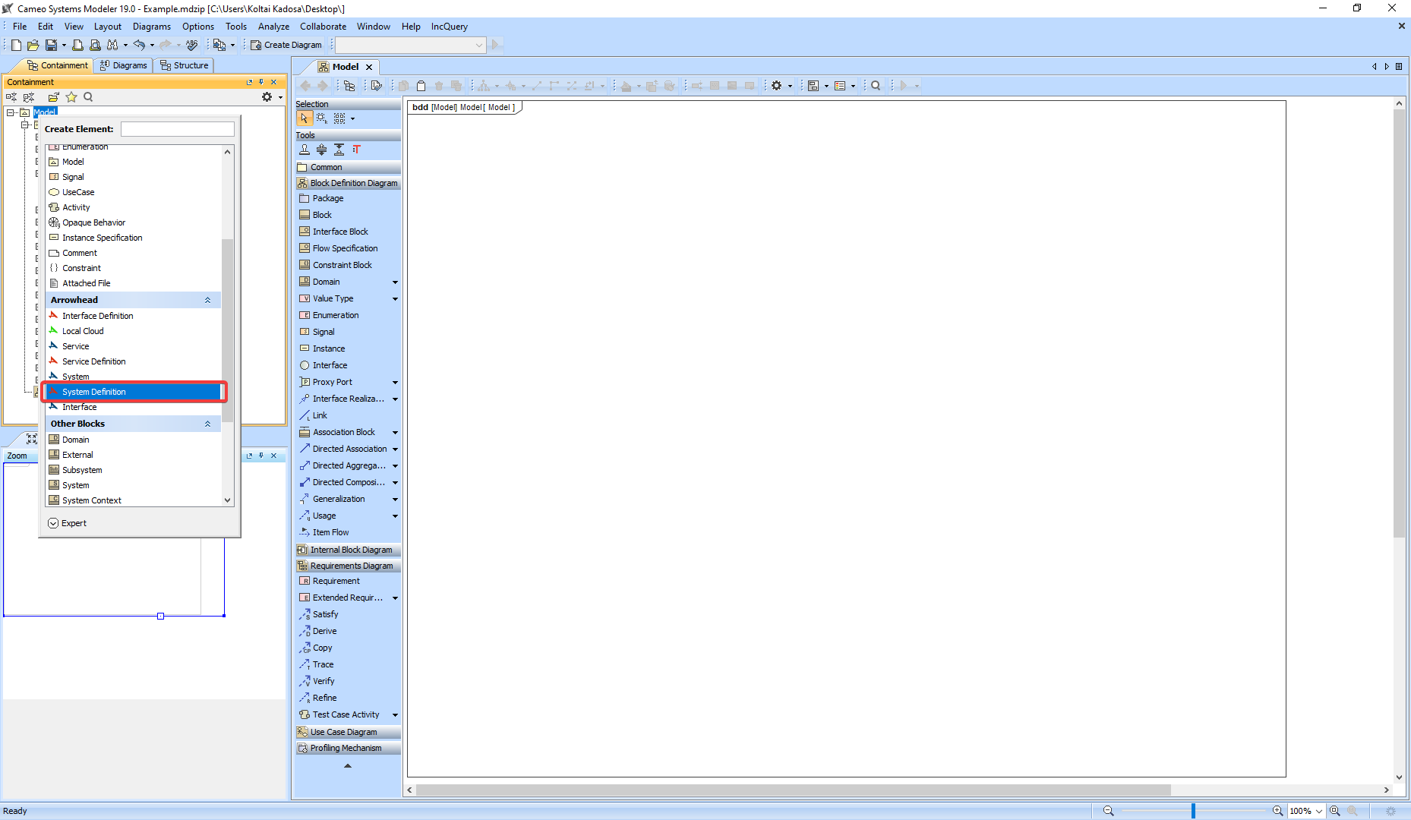
6: Create the System Definition

Slide 12
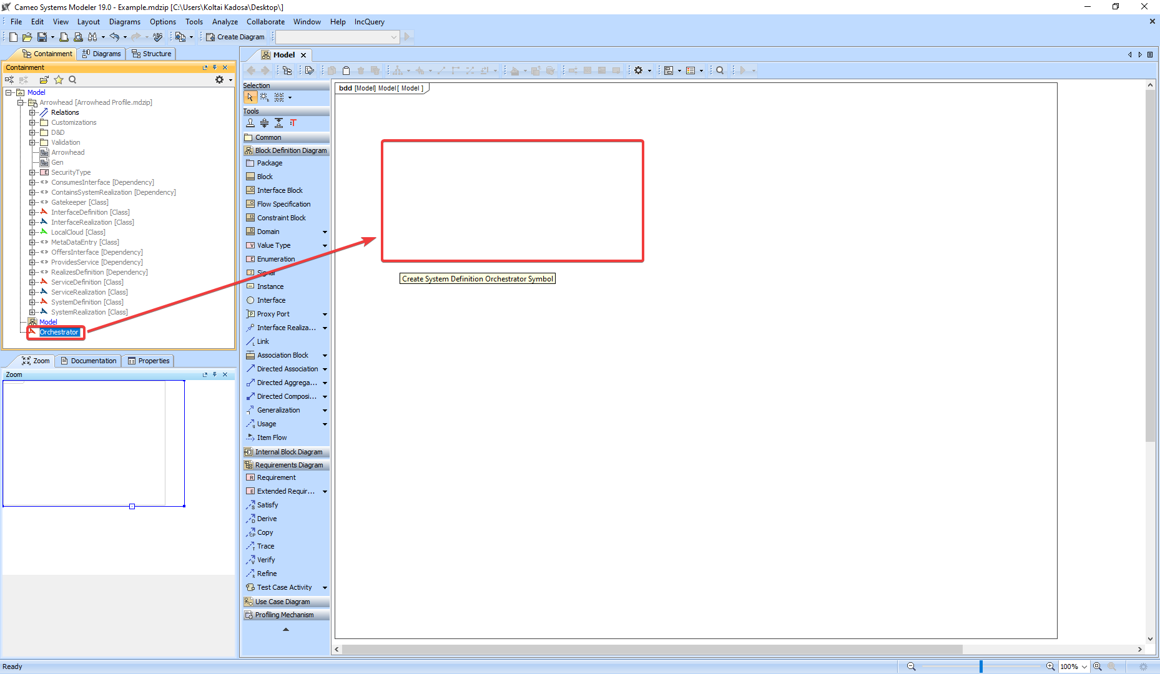
Name it, then
7: Drag & Drop it on the diagram

Slide 13
8: Create the System Realization

Slide 14
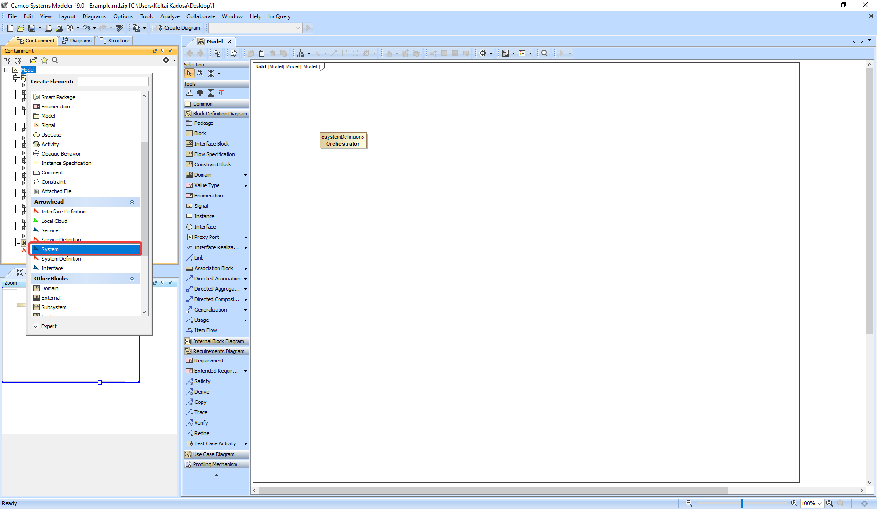
8: Create the System Realization

Slide 15
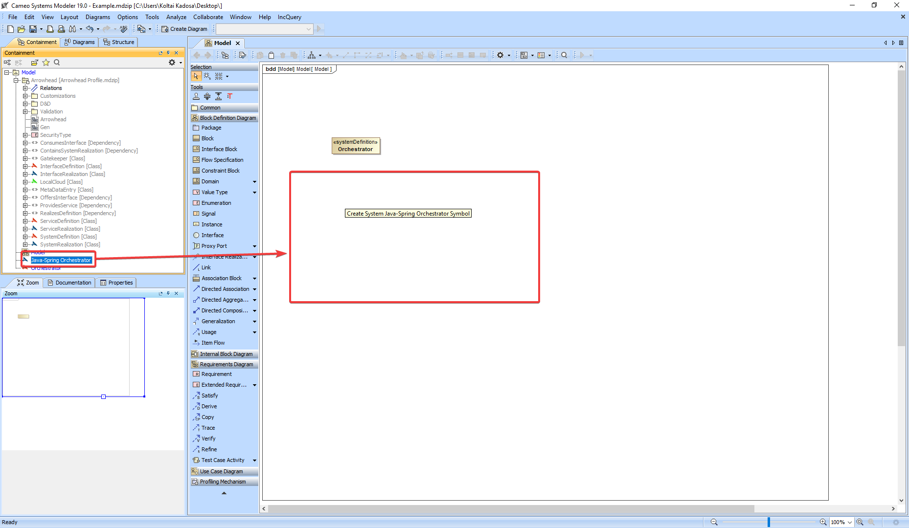
Name it, then
9: Drag & Drop it on the diagram

Slide 16
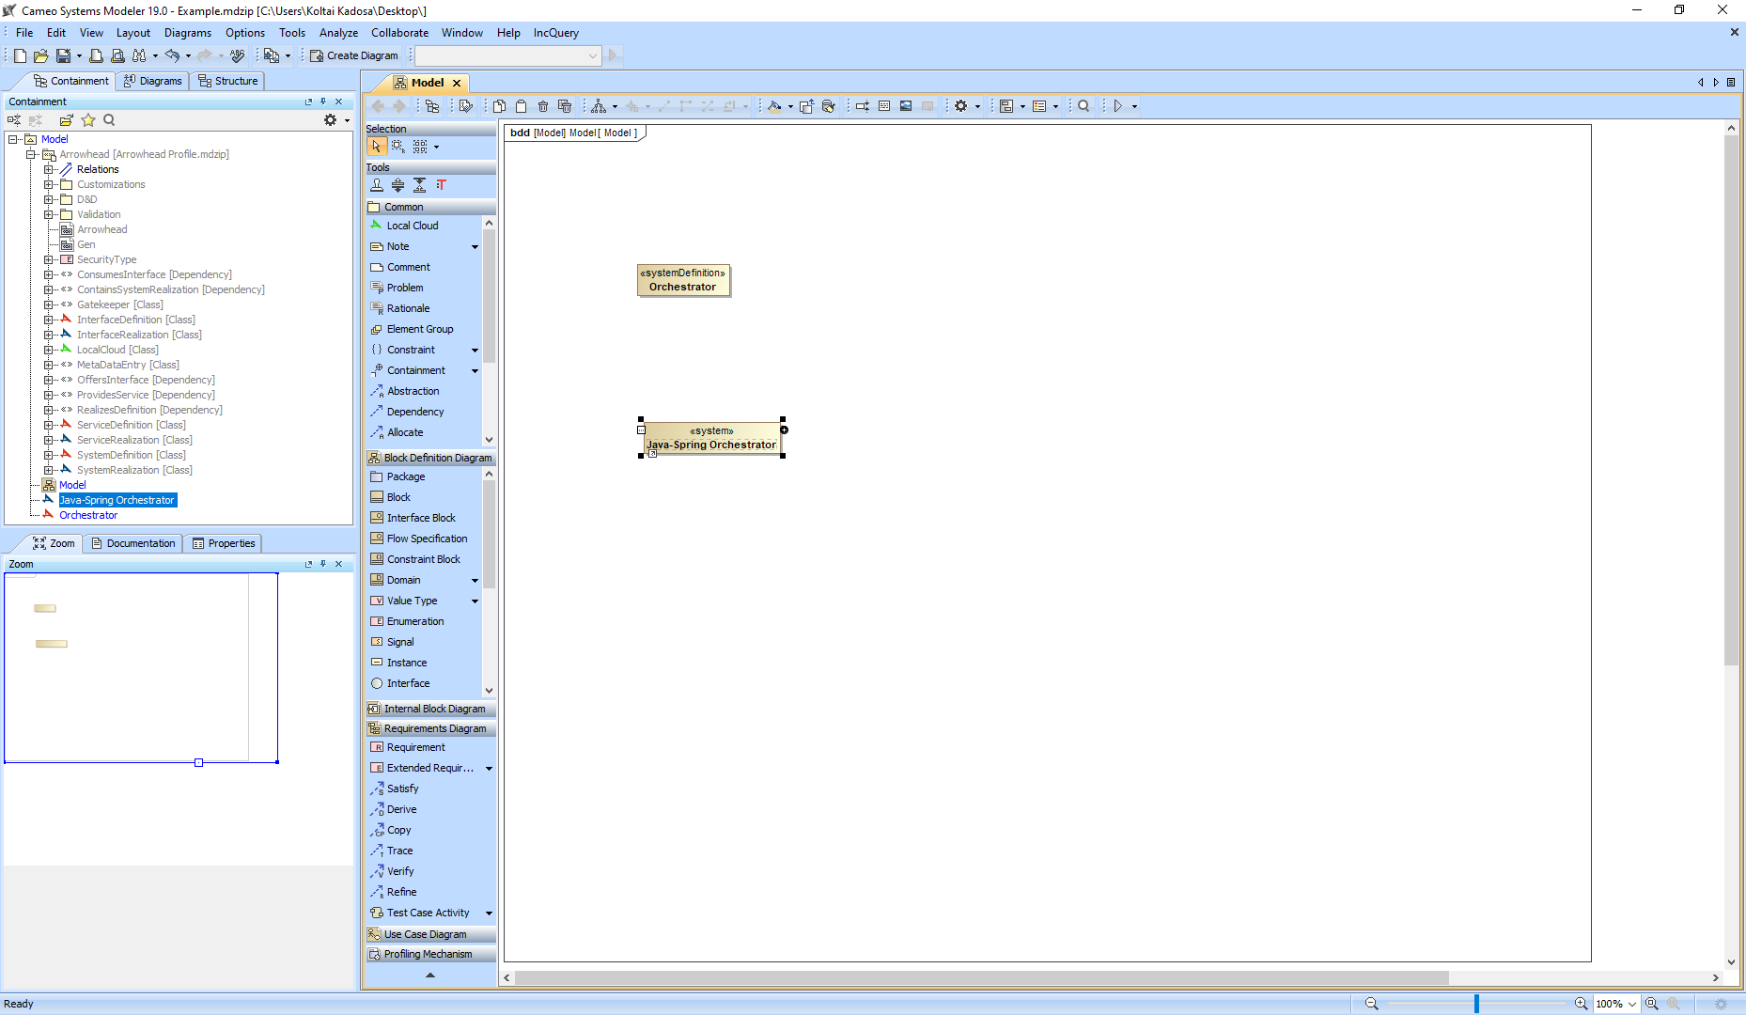
8: Create the System Realization

Slide 17
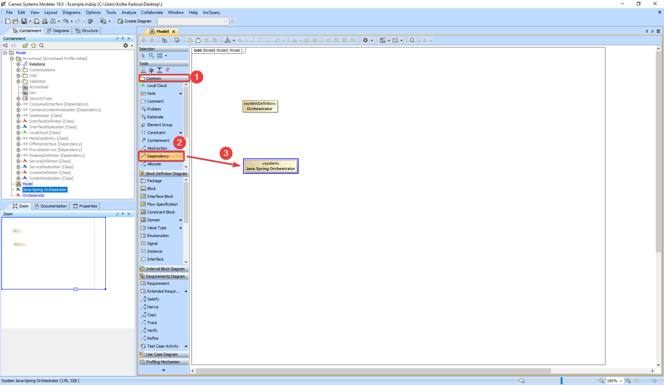
10: Adding the edge
10.1: Open the “Common” tab by clicking on it
10.2: Click on the dependency, see the cursor change
10.3: Click on the source element

Slide 18
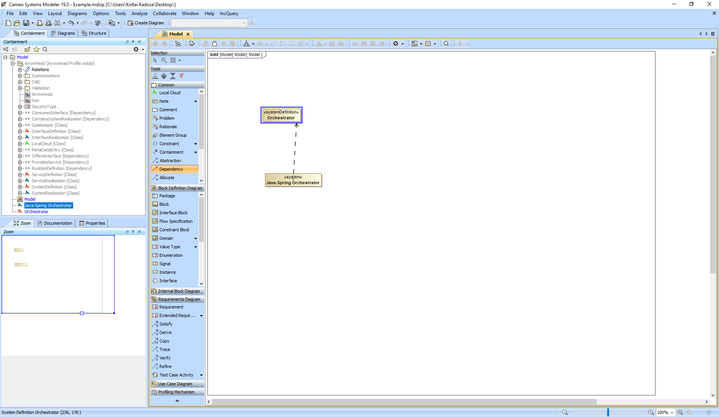
10: Adding the edge
10.4: Click on the target element

Slide 19
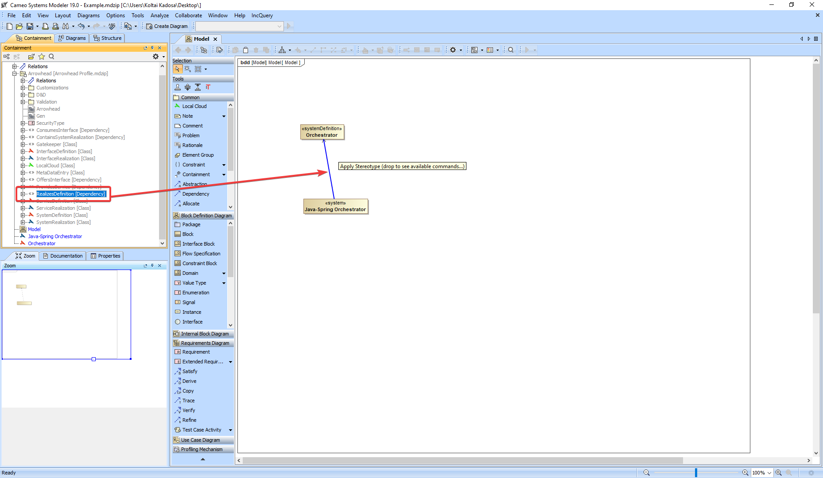
11: Add the stereotype onto the dependency by Drag & Dropping it from the outline

Slide 20
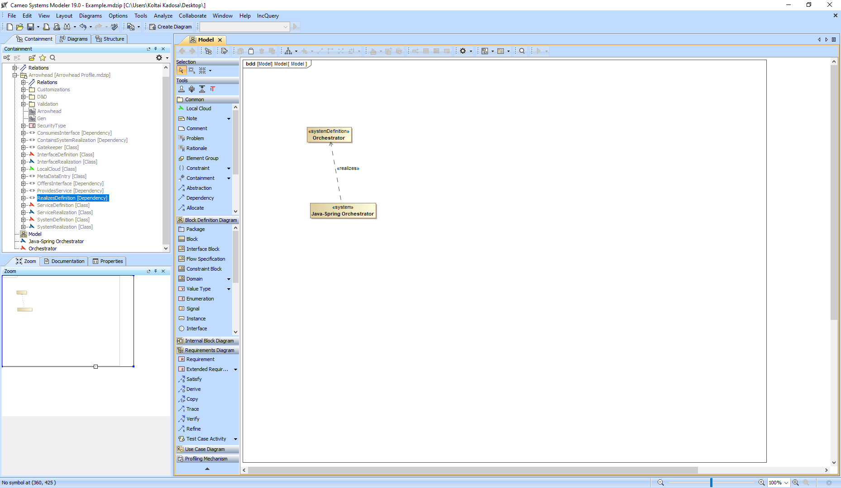
12: Don’t forget to save

